Slide 1
E-Commerce Customer Behaviour Analysis using Gen AI
Transforming Customer Data into Actionable Business Insights
Name : Shreyas Rajendra Mayekar
Course name : Exploratory Data Analysis using Python
Date : 19/06/2026

Slide 2
Problem Statement
E-commerce businesses generate large amounts of customer data, but extracting meaningful insights from this data can be challenging. Understanding customer spending patterns, membership performance, satisfaction levels, and purchasing behavior is essential for making informed business decisions. This project aims to analyze customer behavior data and develop an interactive dashboard that helps identify key trends, customer segments, and business opportunities.

Slide 3
Project Objective
The objective of this project is to analyze customer behavior using data analytics techniques and build an interactive dashboard that provides insights into customer spending, membership performance, satisfaction levels, and purchasing patterns. The dashboard enables stakeholders to make data-driven decisions for improving customer engagement, revenue generation, and business performance.

Slide 4
Dataset Overview
The dataset contains customer-related information collected from an e-commerce platform. It includes customer demographics, city information, membership types, total spending, items purchased, customer ratings, satisfaction levels, and purchase history. The dataset was analyzed using Python, Pandas, Plotly, and Streamlit to uncover customer behavior patterns and generate actionable business insights.

Slide 5
Tools & Technologies used
Python : Core programming language for analysis and dashboard development
Pandas : Data cleaning, transformation, and analysis
SQL : Data querying and business analysis
Streamlit : Interactive dashboard development
VS Code : Dashboard Development
NumPy : Numerical computations and data processing
Matplotlib :Exploratory visualizations and analysis
Seaborn :Statistical visualizations and outlier detection

Slide 6
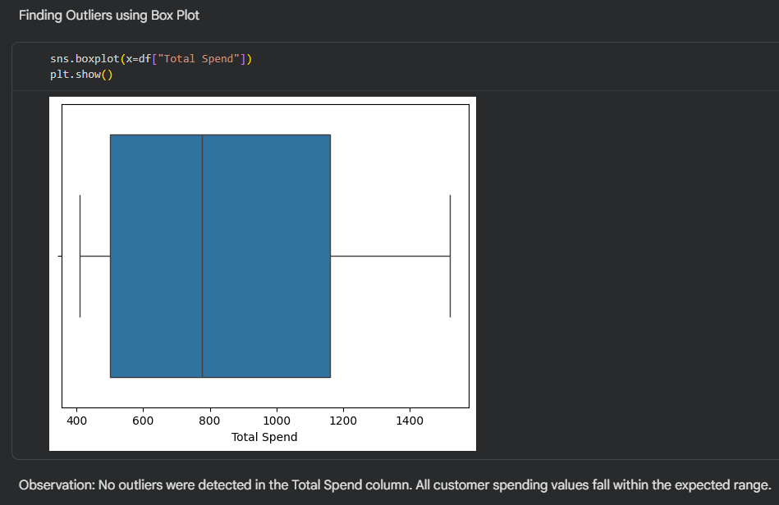
Outlier Detection

Slide 7
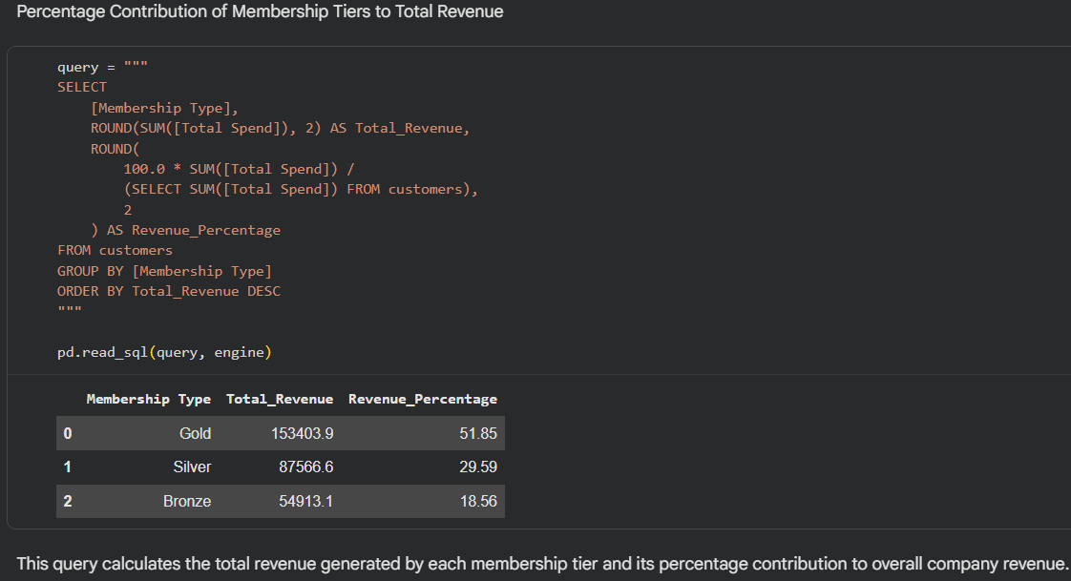
SQL Analysis

Slide 8
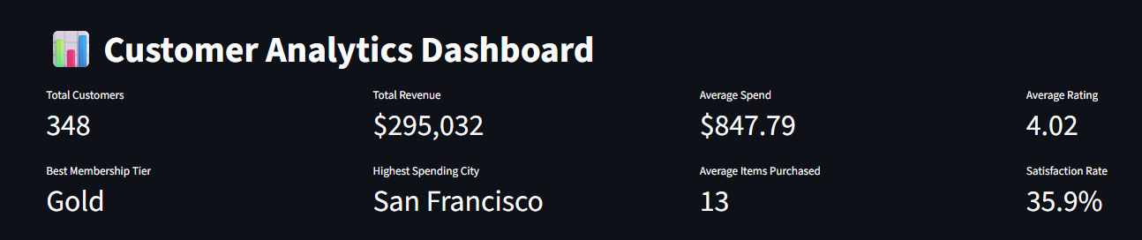
Dashboard Overview
Gold members generate the highest business value.
San Francisco is the strongest-performing market.
Customer ratings remain consistently positive (4.02/5).
Customer satisfaction presents an opportunity for improvement.

Slide 9
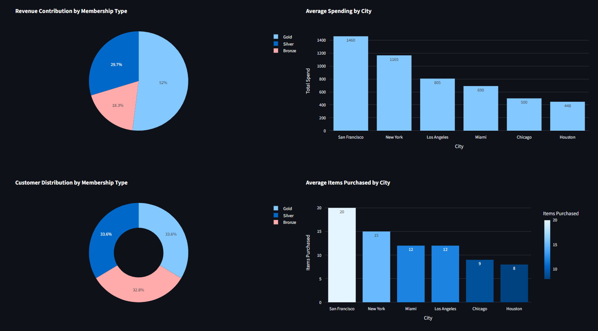
Overview Analysis

Slide 10
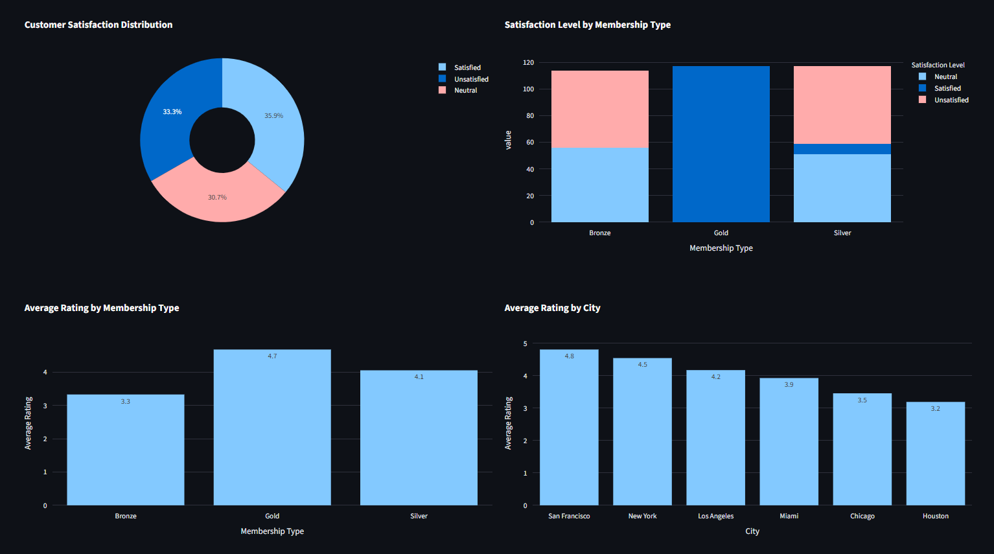
Customer Analysis

Slide 11
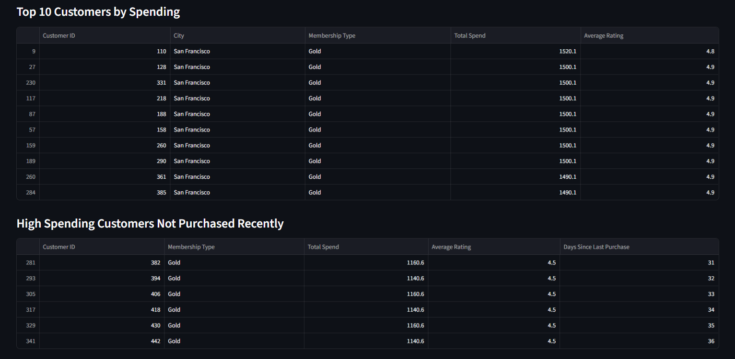
Business Insights

Slide 12
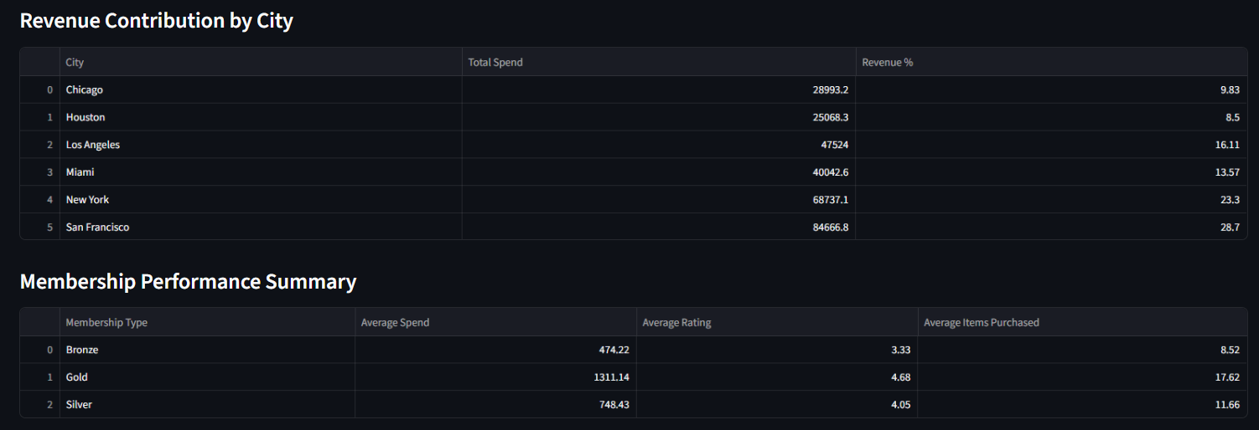
Business Insights

Slide 13
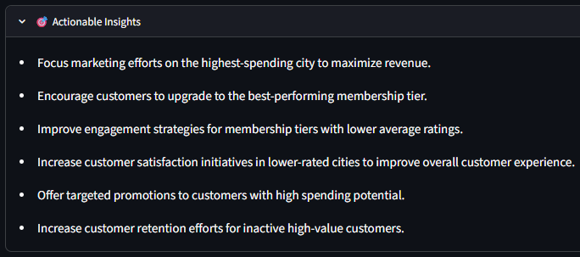
Data-Driven Recommendations

Slide 14
Key Findings
Gold Membership Tier generated the highest overall revenue.
Certain cities showed significantly higher average customer spending.
Customer distribution varied across membership tiers, highlighting differences in customer engagement.
Customer satisfaction levels were generally positive across the customer base.
Average ratings remained consistently high across most cities and membership types.
Some high-spending customers had not made recent purchases, indicating opportunities for customer retention campaigns.
Purchasing behavior differed across cities, with some cities showing higher average items purchased per customer.

Slide 15
Conclusion
The analysis revealed valuable insights into customer spending behavior, membership performance, customer satisfaction, and purchasing patterns. The interactive dashboard provides a comprehensive view of business performance and customer engagement. The findings can support strategic decisions related to marketing, customer retention, membership programs, and revenue growth. By leveraging data-driven insights, businesses can improve customer experience and optimize overall performance.

